Slide 1

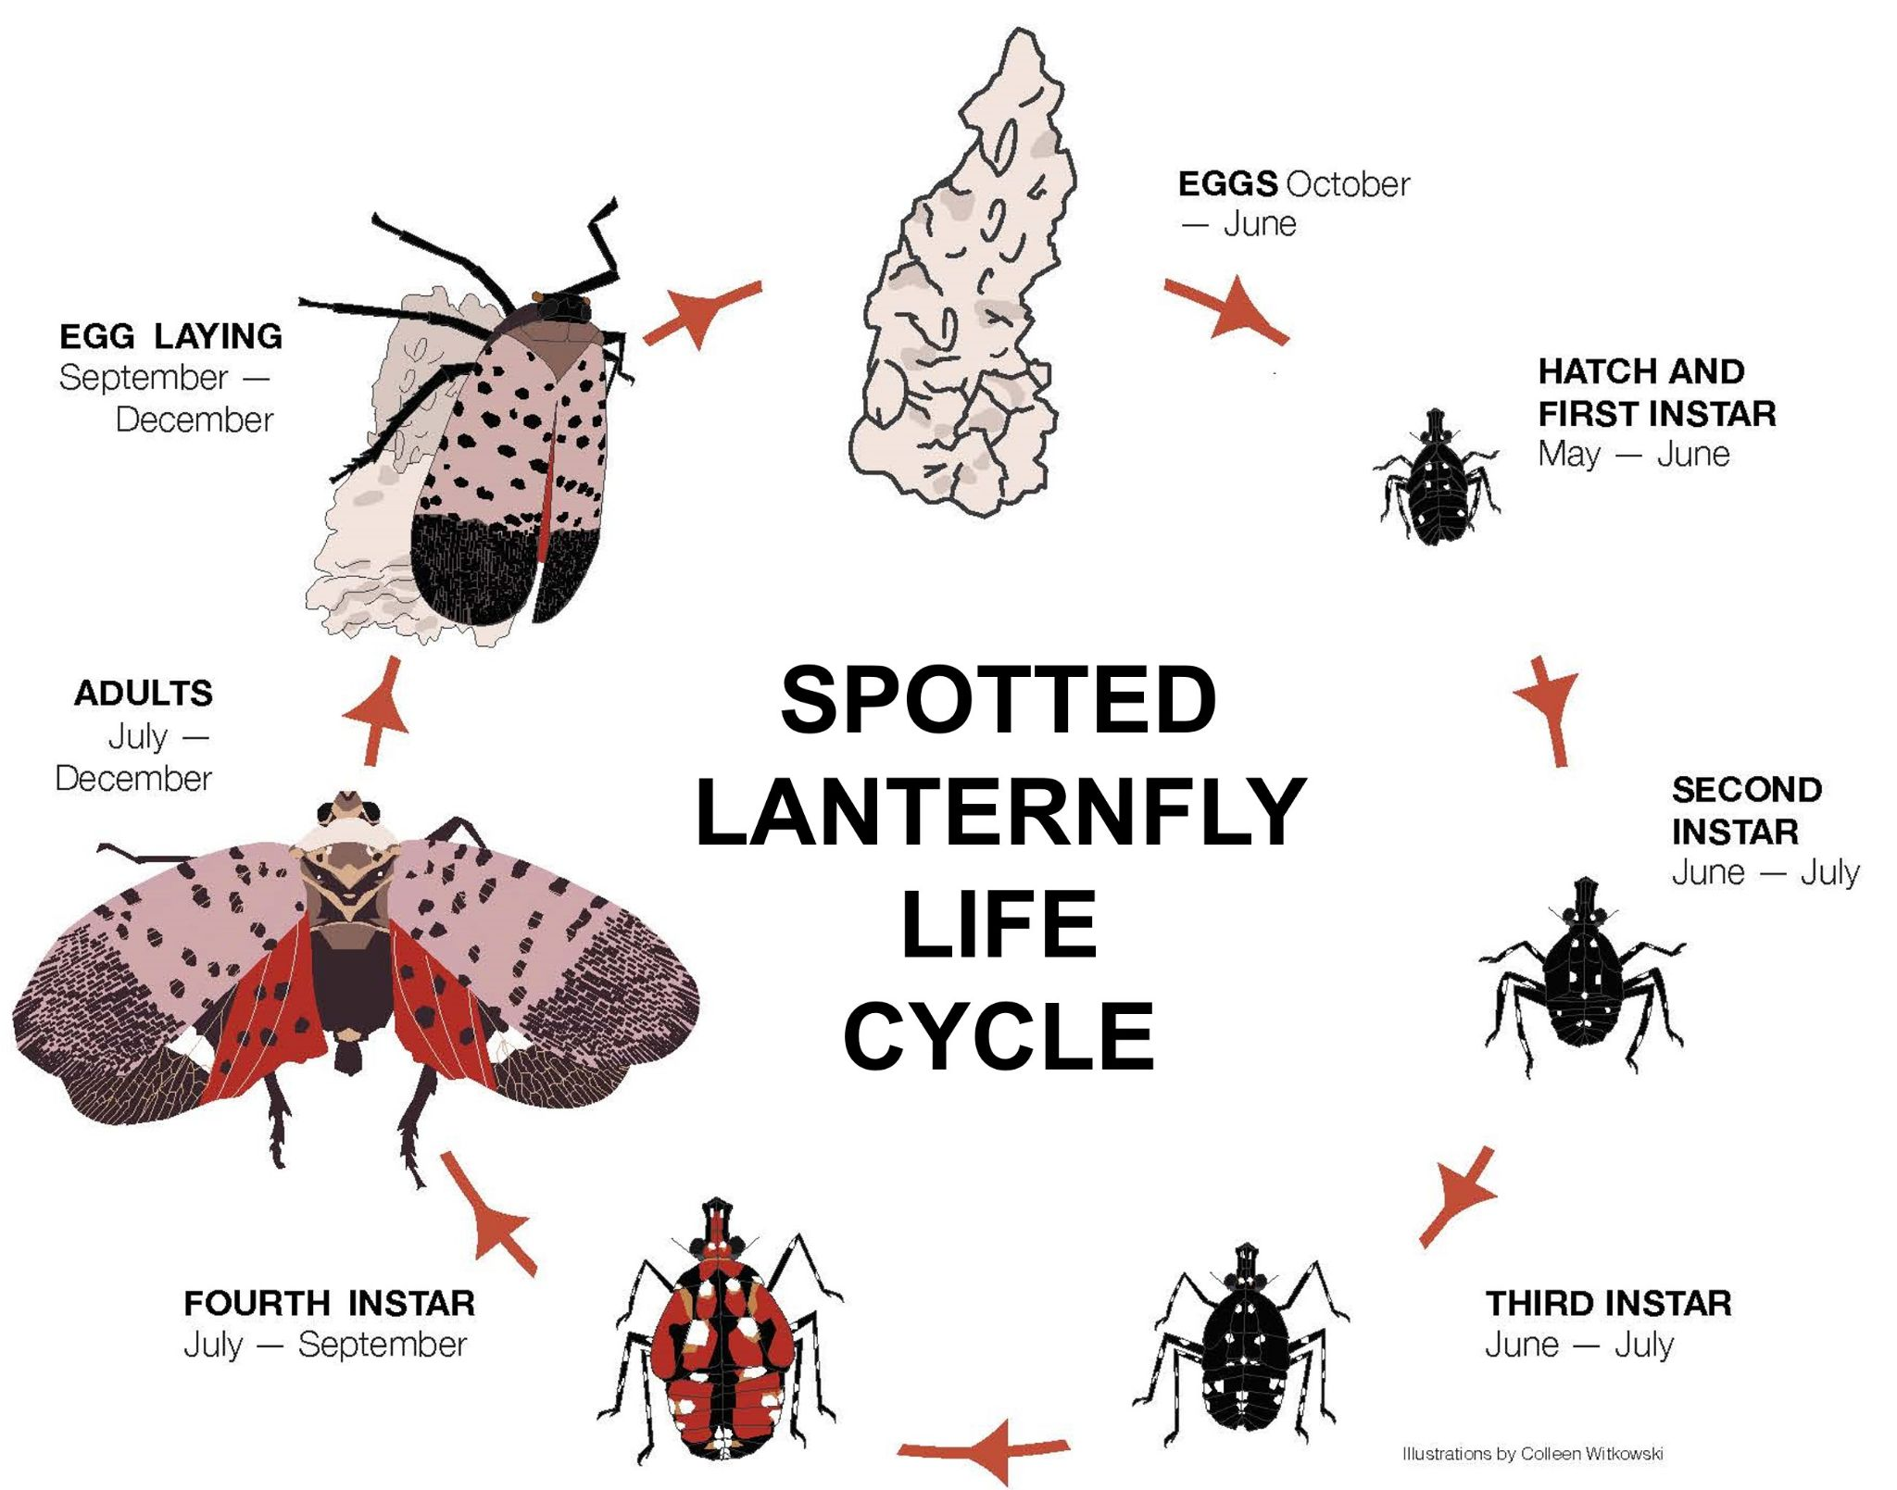
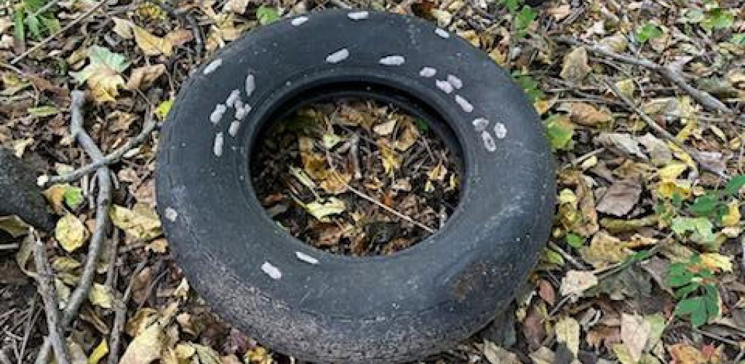
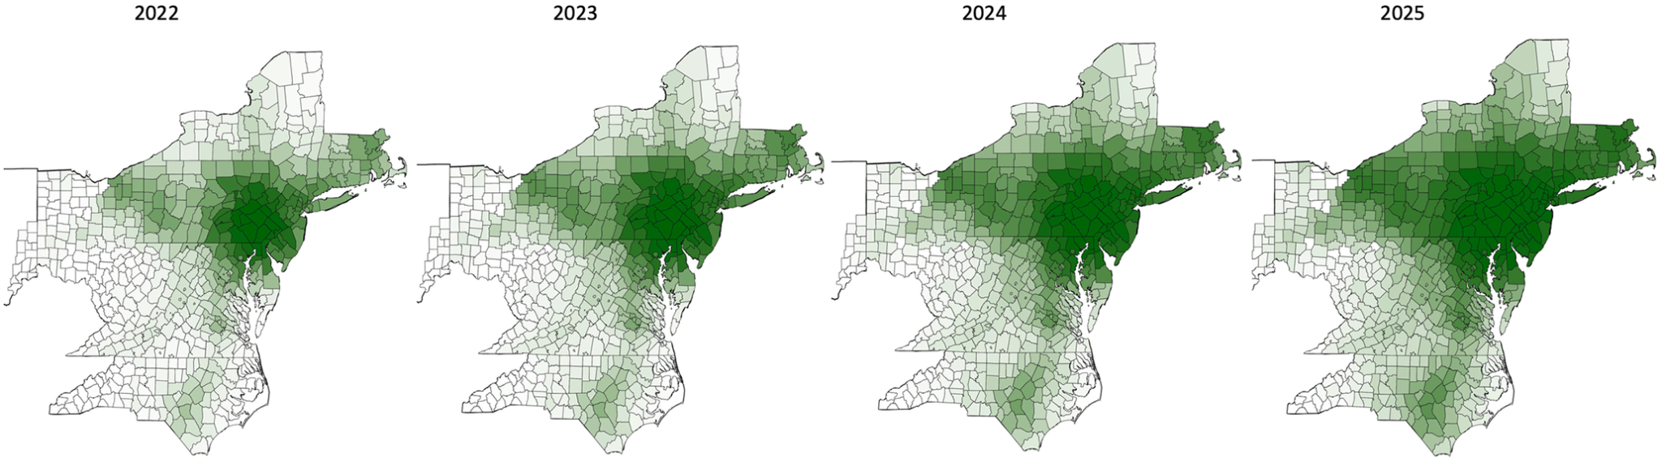

Predictive model of the spread of the spotted lanternfly in the continental United States using machine learning
Erica Keklak (ejk26@njit.edu) | Advisor: Dr. Selina Cai
Department of Mechanical and Industrial Engineering, New Jersey Institute of Technology
Background
¤ The spotted lanternfly (Lycorma delicatula or the SLF) is an invasive plant parasite in the continental United States introduced in 2014
¤ SLFs deplete nutrition from various farmed fruit plants and timber trees, lower American companies’ profits by millions of dollars each year, reduce available resources, and cause environmental distruption for North American ecosystems
¤ Native predators and some effective insecticides exist, but natural enemies, pesticides, and current levels of human intervention are not sufficient to prevent their spread
¤ Historical mapping of spread indicates that SLFs tend to spread faster when egg masses are laid on automobiles, trains, or large parking areas and when nymphs and adults use vehicles to “hitchhike”
¤ Previous research focuses on specific aspects of SLF biology and spread but does not synthesize information to the point of being able to assign levels of risk to areas that may see significant population increases
Methods
¤ Create historical distribution maps to understand how SLFs have spread in the continental U.S. so far
¤ Train species distribution/niche models (SDMs) to predict future SLF locations using public observation data and biological characteristics of SLFs
¤ Models will take into account climate and densities of predators, parasites, locations where effective pesticides may be used, and locations of nearby highways and train lines
¤ Make additional “prediction of risk” SDMs specific to human-mediated dispersal areas, highlighting land transportation corridors, parking, and train stations
Expected Outcomes
¤ Modified historical maps of SLF population density in the U.S. from 2014 to 2024, the full historical timespan
¤ Maps of historical spread of SLFs (2014-2024) along interstate and major intrastate highways, locomotive lines, highway rest stops, and train stations
¤ “Prediction of risk” SDM from cleaned SLF observation data with other parameters involved, risk levels directly coming from expected increases in SLF density
¤ State governments and farmers may see the expected risk and SLF density level of their area and take action accordingly
¤ Future research may test different approaches to modeling future spread using other frameworks (e.g. multispecies diffisuve models) or testing a new framework for predictive accuracy
Figure 1: Life cycle of the average L. delicatula illustrated by Colleen Witkowski from Penn State University, showing the months in the U.S. when each stage is present within quarantine zones.
Figure 2: An example of the size and appearance of spotted lanternfly egg masses and how many can fit in a single part of a land transportation vehicle (“Rubber Tire Containing”, 2023).
Figure 3: Predictive model forecast by Strömbom et al. (2024).
Significance
¤ SLFs will continue to cause damage to native biodiversity and fruit farms unless the government implements an effective solution to regulate their population
¤ Previous literature mapped some historical locations of spotted lanternflies and host plants but did not account for limitations of observation/location bias to determine true population densities
¤ Predictive spread models for SLFs in other literature did not account for areas on the west coast, unlike this project
Acknowledgements
We are grateful for the entities that provided publicly-available data for the training of the models, including the United States Department of Agriculture; iNaturalist; and State Departments of Agriculture in New Jersey, New York, Pennsylvania. We would like to thank Dr. Emily Tancredi-Brice Agbenyega for her generous feedback on this proposal and for any and all programs that accept and/or fund this research. Advising from Dr. Selina Cai is essential to the current and future success of this project.
Resources
Dara, S. K., Barringer, L. & Athurs, S. P. (2015). Lycorma delicatula (Hemiptera: Fulgoridae): A New Invasive Pest in the United States. Journal of Integrated Pest Management, 6(1), 20. https://doi.org/10.1093/jipm/pmv021 Strömbom, D., Sands, A., Graham, J. M., Crocker, A., Cloud, C., Tulevech, G. & Ward, K. (2024, August 14). Modeling human activity-related spread of the spotted lanternfly (Lycorma delicatula) in the US. PLOS One, 19(8), e0307754. https://doi.org/10.1371/journal.pone.0307754
Notes:
The HIRF poster, which is the main slide that will be shown. The rest are figures that are individually shown if the audience wants to see them in greater detail.

Slide 2
Figure 1: Life cycle of the average L. delicatula illustrated by Colleen Witkowski from Penn State University, showing the months in the U.S. when each stage is present within quarantine zones.
Notes:
A figure that is of increased size.

Slide 3
Figure 2: An example of the size and appearance of spotted lanternfly egg masses and how many can fit in a single part of a land transportation vehicle (“Rubber Tire Containing”, 2023).
Notes:
A figure that is of increased size.

Slide 4
Figure 3: Population density maps for the total spotted lanternfly population as predicted by Strömbom, Sands, Graham, Crocker, Cloud, Tulevech, and Ward in a paper published on PLOS One in 2024 with the 2025 map being a predictive forecast for this year’s swarm within and slightly outside of the predefined quarantine zones (Pennsylvania, New York, New Jersey, Delaware, Maryland, Ohio, Virginia, North Carolina, and a few counties in surrounding states). Darker green areas are more dense.
Notes:
A figure that is of increased size.

Slide 5
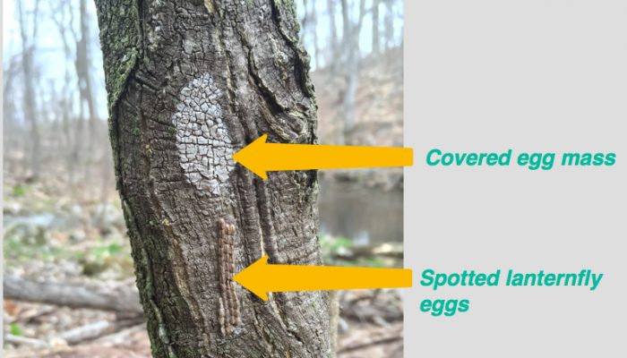
Figure 4: The differences between a covered egg mass (an egg mass protected by a dried wax coating) and an uncovered egg mass (sets of eggs laid in a line). A covered egg mass appears over eggs that have yet to hatch, and uncovered eggs have hatched. Courtesy of the Spotted Lanternfly Project (2020).
Notes:
A figure that is of increased size.

Slide 6
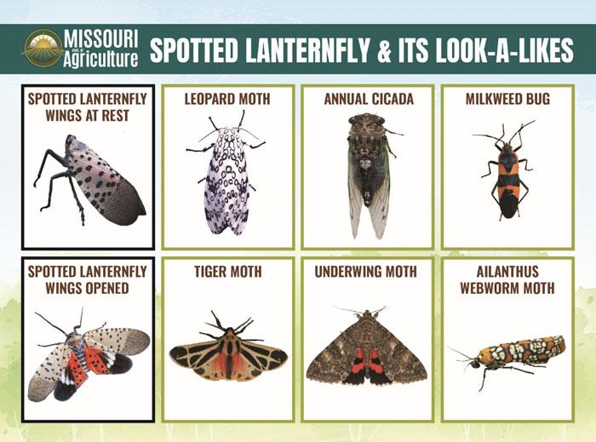
Figure 5: Insects that may appear similar to the adult spotted lanternfly and should be spared from attempts to eliminate invasive species. Note the spotted red area of the hind wings in the target species.
Notes:
A figure that is of increased size.

